Slide 1
Week 5 Lab 4 web2
Dr : Rasha
Eng : Gehad Mustafa

Slide 2
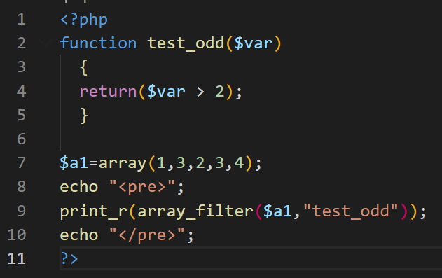
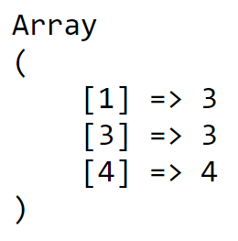
array_filter
array_filter(array, call back function, flag)

Slide 3
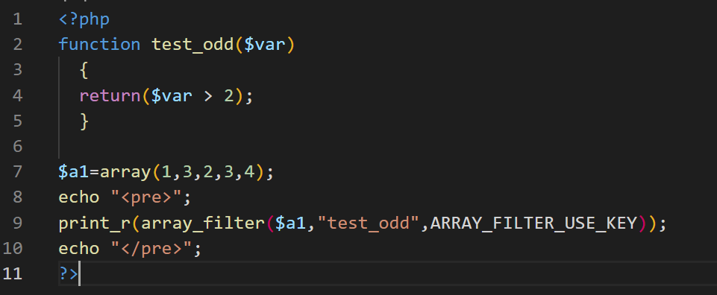
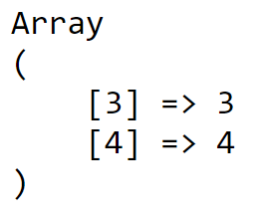
ARRAY_FILTER_USE_KEY

Slide 4
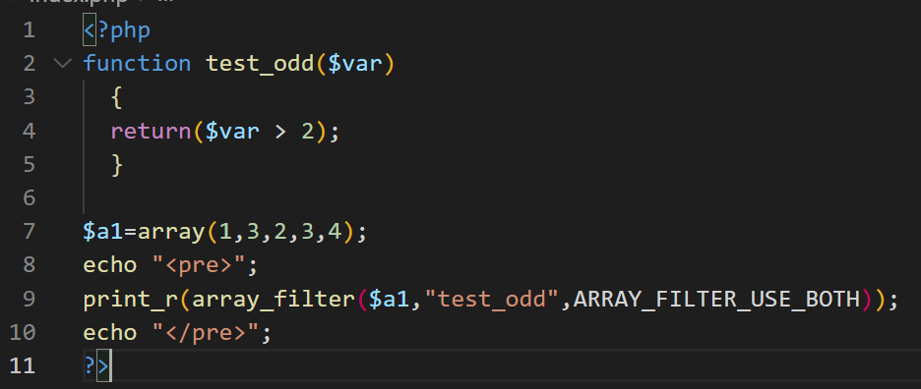
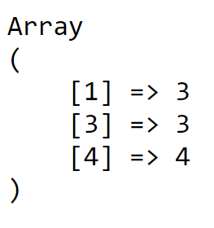
ARRAY_FILTER_USE_BOTH

Slide 5
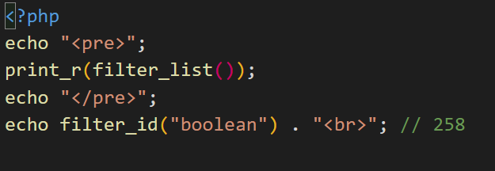
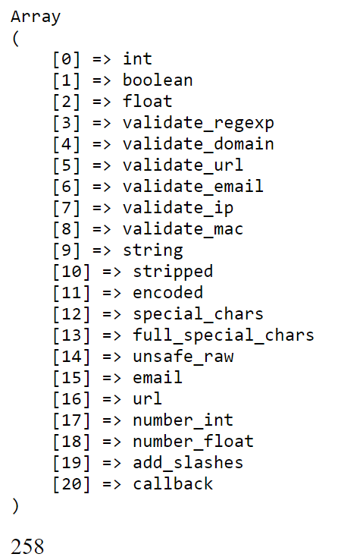
Filter_list

Slide 6
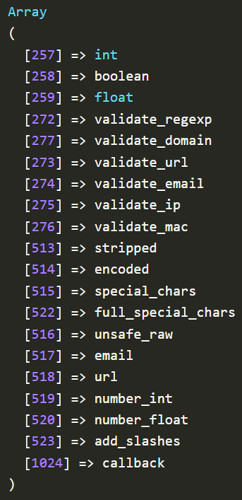
Try

Slide 7
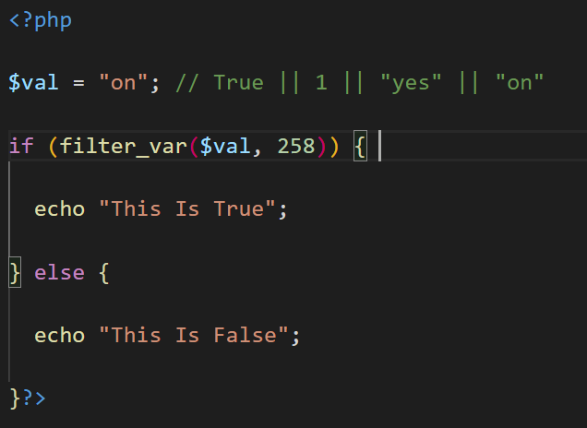

FILTER_VALIDATE_BOOL (258)

Slide 8
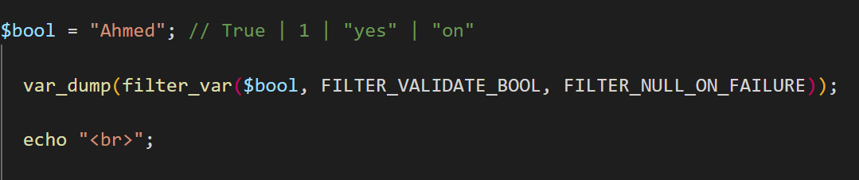

FILTER_NULL_ON_FAILURE

Slide 9
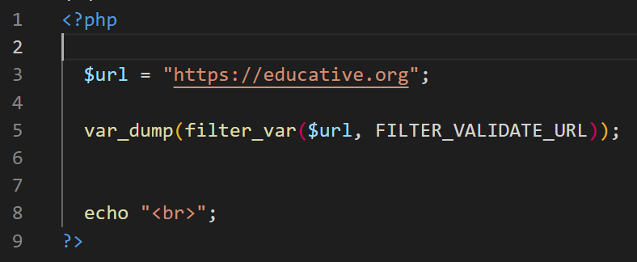

FILTER_VALIDATE_URL

Slide 10
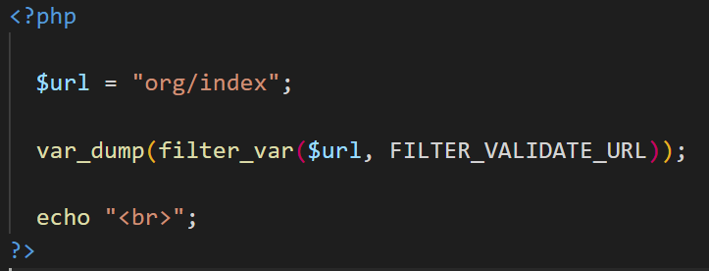

FILTER_VALIDATE_URL

Slide 11
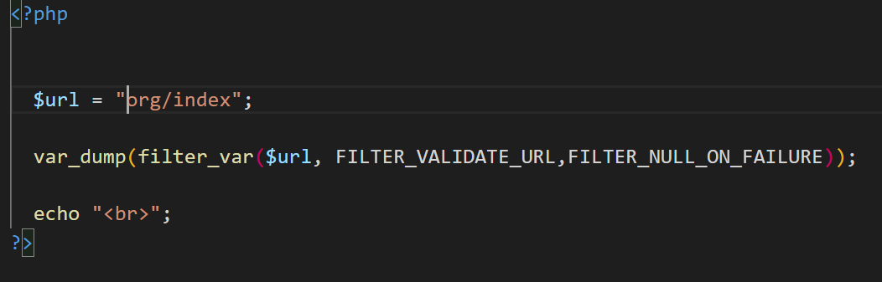

FILTER_NULL_ON_FAILURE

Slide 12
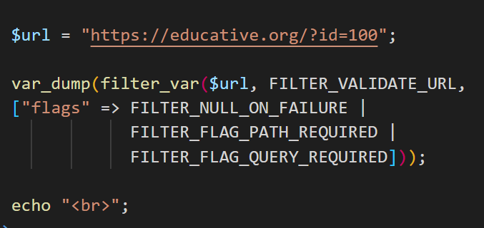

flags

Slide 13
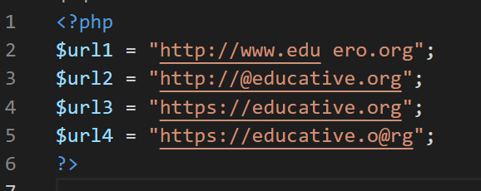
Try

Slide 14
Files

Slide 15
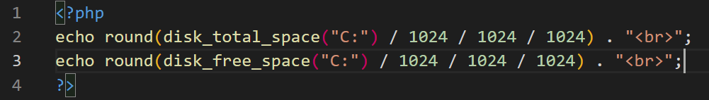
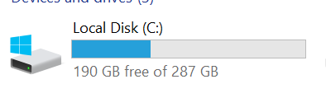

Disk space

Slide 16
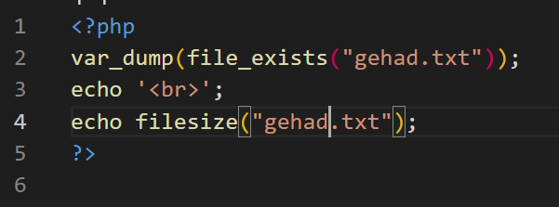

File

Slide 17
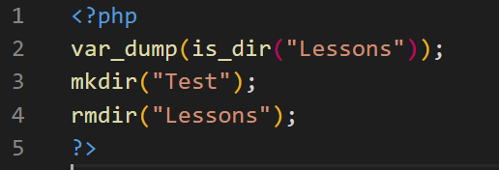


DIR

Slide 18
Fopen
[r] For Read => Pointer At The Beginning .
[r+] For Read & Write => Pointer At The Beginning .
[w] For Write => Pointer At The Beginning => Create If Not Exists.
[w+] For Read & Write => Pointer At The Beginning => Create If Not Exists.
[a] For Write => Pointer At The End + Create If Not Exists
[a+] For Read & Write => Pointer At The End + Create If Not Exists

Slide 19
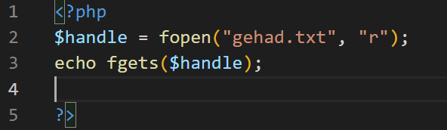
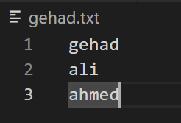

Fgets

Slide 20
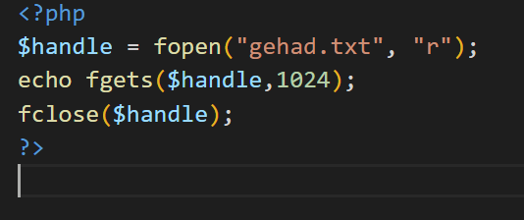
Fgets

Slide 21
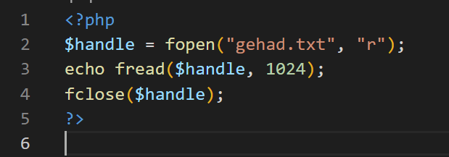

fread

Slide 22
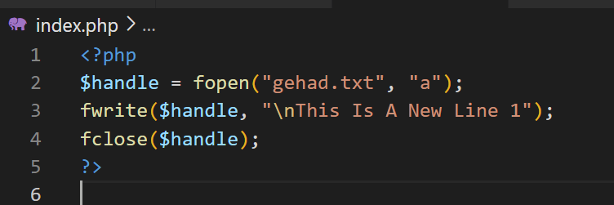
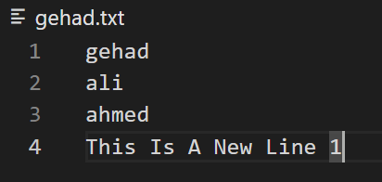
append

Slide 23
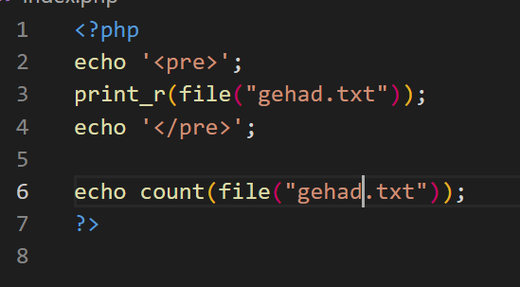
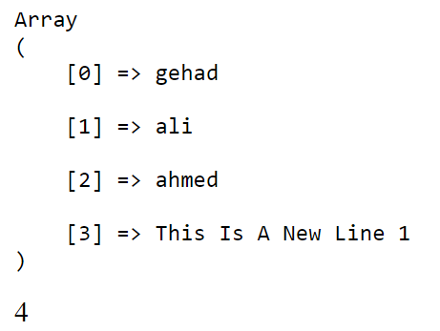
file

Slide 24
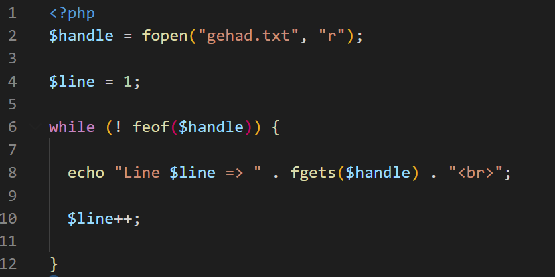
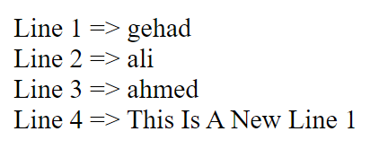
File read

Slide 25
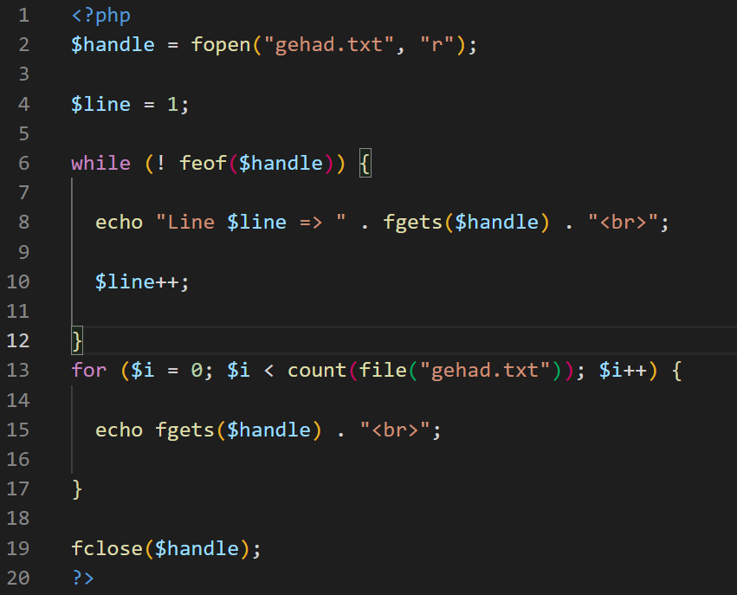
File read

Slide 26
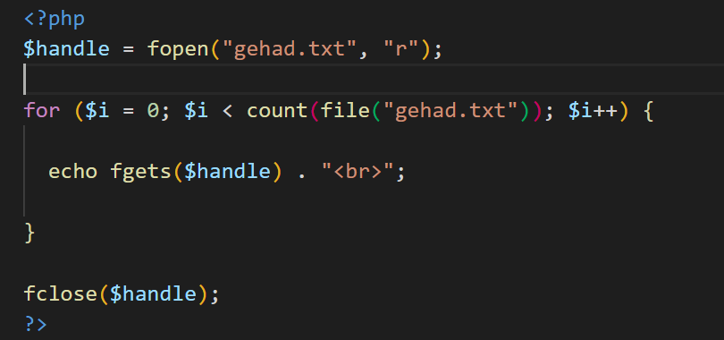
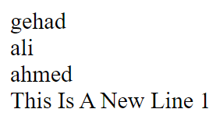
File read

